Slide 1
PROBLEM STATEMENT
Voice controlled bot which can follow the voice command with ultrasonic sensor and can detects any obstacles .

Slide 2
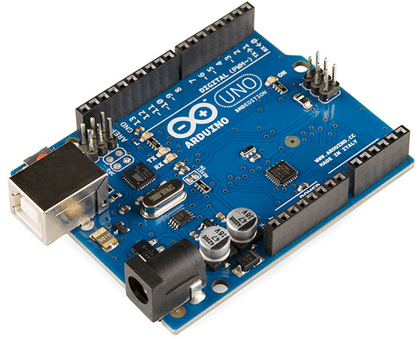
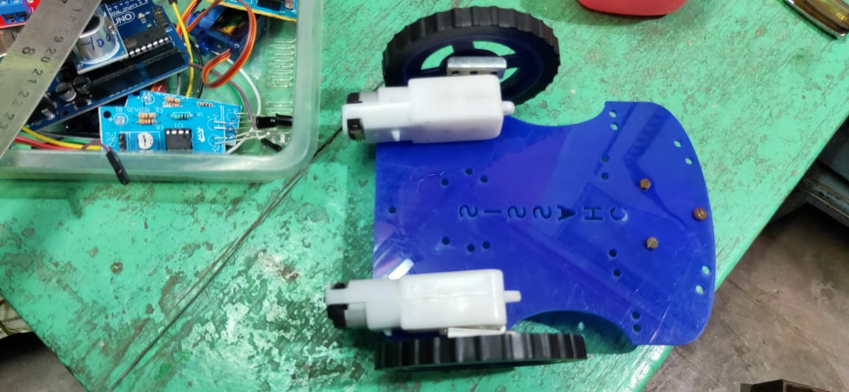
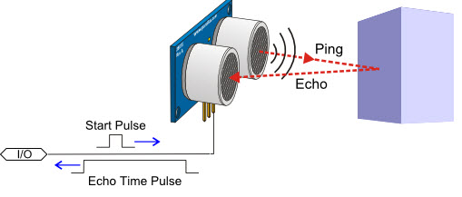
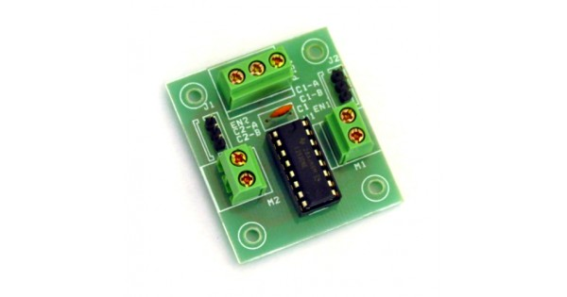
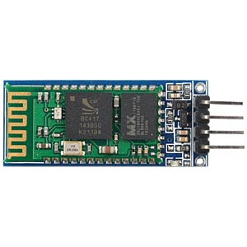
HARDWARE USED
Arduino Uno - 1 piece
Ultrasonic sensor-3piece
Chassis - 1 piece
DC motor- 2 pieces
Castor wheel-1 piece
Standard wheel-2 piece
Motor driver (L293D)-1 piece
Power source
Bread board
Bluetooth module(HC 05)
Piezo Buzzer

Slide 3
SOFTWARE USED
Arduino Voice Control App
Arduino Integrated Development Environment (IDE)

Slide 4
Working Principle
The communication between the robot and the android application is carried over by the Bluetooth link between the phone’s Bluetooth and the Bluetooth device in the Robot. The ASCII commands are sent from the phone to the Robot which in turn checked by the Arduino for the control of the wheels according to the commands to move the robot in the desired direction.

Slide 5
approach
DC BO Motors attach to the chassis
The Arduino UNO board, Mini breadboard, Motor Driver attached to the chassis.
Fixing the Ultrasonic sensor in all the three directions.
Wheels attach to DC Motors and Bluetooth module attach to the circuit.
Now uploaded the code to the Arduino.
And let the fun begin……………

Slide 6
working
As the command is given to the bot it follows it, if commanded to move forward then it will follow but if there is any obstacle in front of if in the range of 6 cm then it will not follow that command and indicate by piezo buzzer.
The same holds for left and right directions but the tone of piezo buzzer will be different.

Slide 7
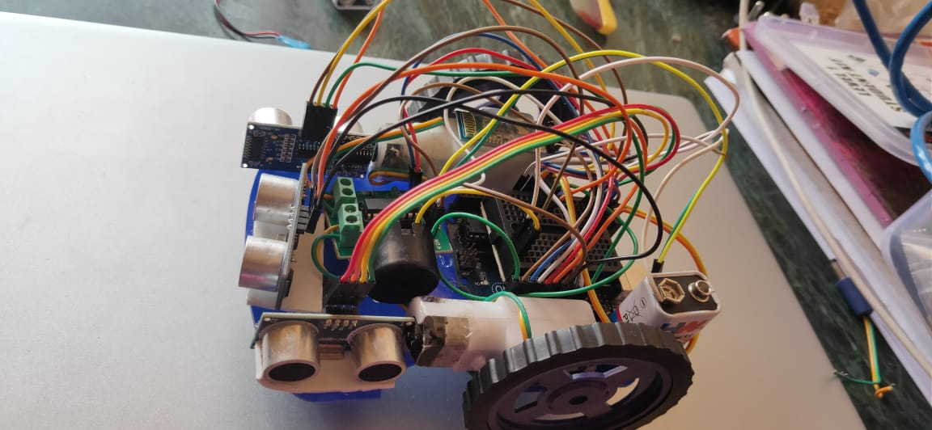

Slide 8
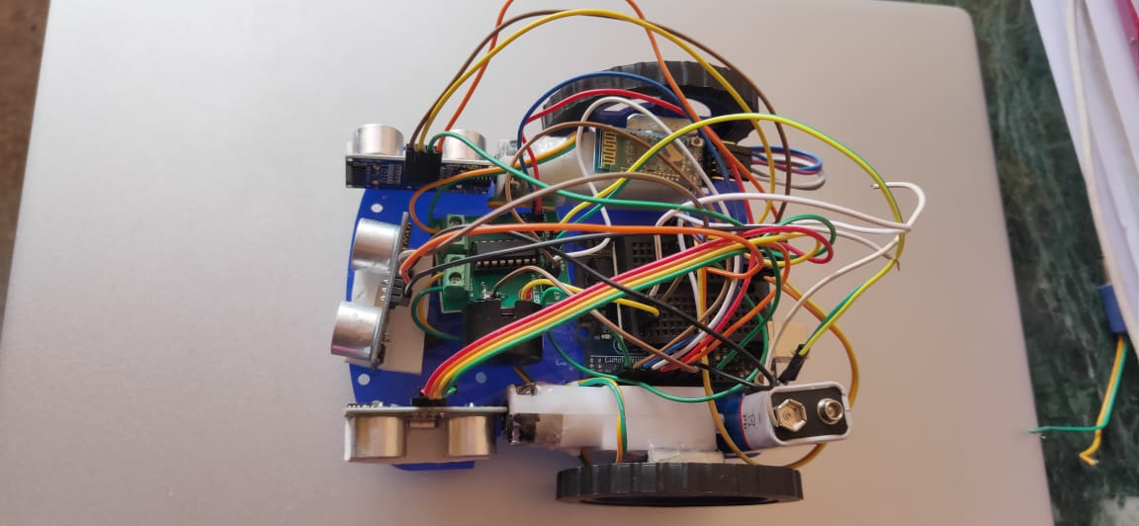

Slide 9
How to use(commands)
Control | Voice command
Forward | ‘forward’
Backward | ‘reverse’
Left | ‘Left’
Right | ‘Right’
Stop | ‘Stop’

Slide 10
